Slide 1
EPAM JavaLab
Bridge pattern
© 2014. EPAM Systems. All Rights Reserved.

Slide 2
What is Bridge pattern used for?
to decouple an abstraction from its implementation (for them to vary independently)
(providing a bridge structure between them)
© 2014. EPAM Systems. All Rights Reserved.

Slide 3
How to implement ?
create an interface which acts like a bridge!
© 2014. EPAM Systems. All Rights Reserved.

Slide 4
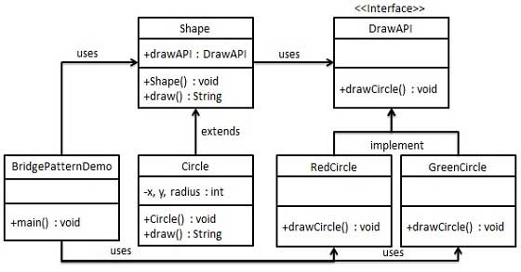
UML
© 2014. EPAM Systems. All Rights Reserved.

Slide 5
Q&A
© 2014. EPAM Systems. All Rights Reserved.

